Slide 1
Project Canvas Template
Instructions For Use
Slide 1: Cover
State the name of the project; insert the name and logo of the implementing agency; name the project representative; and implementation year.
Slide 2: Project Vision Statement
Summarize the overall vision of the project in 30-40 words.
Slide 3: Project Rationale/Need
Begin with a background sentence, followed by a bulleted list of issues/problems to be addressed, and end with the estimated project cost and execution timeline.
Slide 5: Representative Graphic
Insert a graphic, mock-up or other representative photo of the
Slide 4: Project Canvas
Using data from the Project Concept/Proposal Submission. Summarize and provide bulleted information on the following areas:
Project Objectives
Implementing Entities
Project Scope/Components
Expected Outcome/Results
Project Risks
Key Beneficiaries
Project Milestones
Project Cost Structure
Monitoring & Evaluation
Research Inputs
Vision 2030 & the MTF Alignment
This template includes 3 canvas designs; use the most appropriate and delete the others.
DELETE THIS SLIDE PRIOR TO PRESENTATION

Slide 2
Document Control
Quality Control & Versioning Information
Document Title | Project Canvas Template |  | Version | 1
Abstract/Purpose | For use by project proponents in the presentation of concepts/proposal to TRC and PIMC
Classification | Open | Distribution Type | Unrestricted
Approval Date | 04 November 2020 | Date of Circulation | 23 December 2020
Lead Author: Mr. Rohan Wright | Master Controller: Mrs. Anieta Lewis
Change History
20220318 – Critical revisions and approval / AL
20220202 – Structural revisions for MDA use / RW
20211027 – First version created / RW
DELETE THIS SLIDE PRIOR TO PRESENTATION

Slide 3
St. Augusta Courthouse
Project Overview
2022
Ministry of Court Affairs
Prepared by the Ministry of Court Affairs for the Technical Review Committee and Public Investment Management Committee meetings

Slide 4
Project Vision Statement
A 33,000 sq.ft courthouse for the parish of St. Augusta, outfit with modern technology, 10 court rooms and new facilities to meet the increasing demand for justice services in the parish.

Slide 5
Project Rationale/Need
The current structure of the St. Augusta Courthouse was a temporary solution to meet the needs of the court at the time.
However, it is no longer suitable, as the court currently experiences:
rising case volumes
a wider range of services demanded by the public
inaccessibility to the court facility by persons with disabilities
Poor operational efficiency
Limited use of technology
High case backlogs
The proposed solution will cost an estimated JM$999 million, funded by the Government of Jamaica, and is in keeping with Vision 2030 Goal #99.

Slide 6
PLEASE NOTE:
Project Proponents are required to select only ONE of the canvas layouts presented on the following three slides.
The suggested phrasing and bulleting is presented.
Use bullet points and succinct statements.
Delete unused layouts/slides.
DELETE THIS SLIDE PRIOR TO PRESENTATION

Slide 7
Project Canvas St. Augusta Courthouse – Ministry of Court Affairs
Execution Period
March 2022 - August 2023
Project Objectives
To expand the services of the current court facilities
Improve access to justice services
Accommodate Family Court services
Create technology access points
Improve accessibility to persons with disabilities
Implementing Entities
Expected Outcomes
Greater efficiency in the administration of court services
Improved scheduling of court matters
Resolution services
Improved trust in the justice system
Improved physical access to the court facilities
Wider range of court services available
Project Risks
Delays in obtaining building approvals
Procurement hiccups
Conformance with JNHT protocols vis-à-vis development plans
Milestones
Feb 2022 - Stakeholder Consultation
March 2022 – Ground breaking activities
April 2022 – Construction Activities (Phase 1)
December 2022 – Construction Activities (Phase 2)
March 2023 – Fixtures Installation
August 2023 - Handing Over
Scope/Components
50,000 sq. ft. space
15 court rooms
Holding areas
Offices for victim support services
Project Stakeholders
and/or Beneficiaries
Lawyers/Judges, Court Officers
Residents of St. Thomas
Road users along the construction site
Project Cost Structure
Total: JM$ 000,000,000
Source: Government of Jamaica
Funding Status: Not Secured
Monitoring & Evaluation
Defined theory of change
Indicators
Reporting formats/structure and timelines
Research Inputs
Environmental Impact Report
Staff Surveys
Vision 2030 Goal Alignment
Goal #2 – Jamaican society is secure, cohesive and just
Outcome #5 – Security and Safety
Outcome #6 – Effective Governance

Slide 8
Project Canvas Jamaica Farms Agricultural Development – Agricultural Authority of Jamaica
Execution Period
Sept 2021 – Nov 2026
Project Objectives
Provision of infrastructure and systems with the capacity to supply water to the farm gate of all farms.
Provision of 200 farmers with three (3) Global GAP Combo Structures
Capacity building to improve productivity
Implementing Entities
Expected Outcomes
95% Increase agricultural production within the project area
Access to irrigation for 200 farmers.
Enhanced marketing facilities and systems
350 ha. of new lands coming into production. employment for 1000 unskilled personnel and 500 skilled personnel
Enhanced environmental sustainability to investors through irrigation, drainage and access roadways
Improved post-harvest management and improved food safety standard
Project Risks
Administration of land through farmers group (H)
Availability of surface water to meet demand (M)
Fiscal space constraints (M)
Monitoring & Evaluation
Improved livelihood of farmers – measured through reports from PIOJ, RADA, Agro-Invest
Increased production of selected crops – Target: 85%; Baseline: 999.5 tonnes)
Farm with access to irrigation system – Target 35%; Baseline: 0%
Arable lands with access to irrigation – Target: 350 ha; Baseline: 0 ha.
Farmer group cluster established – Target 1; Baseline 0.
Scope/Components
Irrigation System
Global Gap Combo Structures
Capacity Building
Project Stakeholders
and/or Beneficiaries
200 farmers on 820 ha of irrigable land
Agro-processors
Hotels and restaurants
Regional markets
Small and micro entrepreneurs
Project Cost Structure
Total: JM$ 999,000,000,000.00
Source: Government of Jamaica
Funding Status: Not Secured
Implementation Duration
Total execution duration 3 ½ years from Sept 2020 – Nov 2020.
Project planning period 1 years
Project implementation 5 ½ years
Research Inputs
Reports from NIC, Agro-Invest, RADA and PIOJ
Surveys of Jamaica Jamaica farmers
National Policy Alignment
Vision 2030 National Strategy 9. Ensure adequate and safe water supply and sanitation services
Food & Nutrition Security Policy; Agricultural Land Use Policy; Water Sector Policy et al.

Slide 9
Project Canvas
Dualization of Jamaica Lane
Project Objectives
Widening 0.8 km of Jamaica Lane from 2 to 4 lanes including turning lanes at the junctions​
4 x 3.65 m driving lanes ​
Provision of turning lanes at intersections of: Coconut Grove, Robert Main Road, Kilston Drive, and October Drive​
Widening Box Culvert (near KFC)​
Provision of 1.2 m wide median barrier​ 2 x 1.8m raised concrete sidewalks​
Provision of additional Bus-Bays​
Implementing Entities
Expected Outcomes
Improvements in road safety and capacity for future growth in traffic demand, provision of infrastructure to facilitate economic development
Reduction in travel time by 35% by end 2023 (minutes)
Reduction in vehicle operating costs (VOC) by 29%
Reduction in motor vehicle CO2 emissions by 42%
Project Risks
Poor Project Portfolio management Execution & Supervision
Disruption of Global Supply Chains
Reputational Risk inconvenience to the public disruption in utilities. Denial of access to roads.
Options Analysis
Do Nothing (J$27,485,248.00)
Road Rehabilitation (J$25,249,388.00)
Road Dualization (J$6,875,598.00)
Option 3:
Long-term solution
Increased capacity
Better mobility & connectivity
Enhanced road access properties services
Scope/Components
Widening of 0.8 km of Jamaica Lane
Drainage improvements with the installation of HDPE pipe culverts
Widening of Box Culvert;
Upgrade and connection of sewer main
Street lighting, road markings and signage
Installation of new or upgraded traffic signals with pedestrian facilities
National Policy Alignment
The project is primarily aligned with National Goal Number 3- Jamaica’s Economy is Prosperous and National Outcome #9- Strong Economic Infrastructure. Expand and Rationalize Land Transport Infrastructure and Services
Project Cost Structure
Total $1,150,250,350 JMD
-$1.2 billion – roadworks -$41.5 million – project mgmt -$2 million – M&E
Source: Government of Jamaica
Project Stakeholders
and/or Beneficiaries
Departments & agencies (mdas)
Municipal corporation,
Utilities (telecoms, water)
Community residents
Research Inputs
Greater Bernard Lodge Development Project Plan
Caymanas SEZ
MSET Broadband Initiative
Implementation Period
9 months
Start: Q4 FY 2021/22
End: Q4 FY2022/23

Slide 10
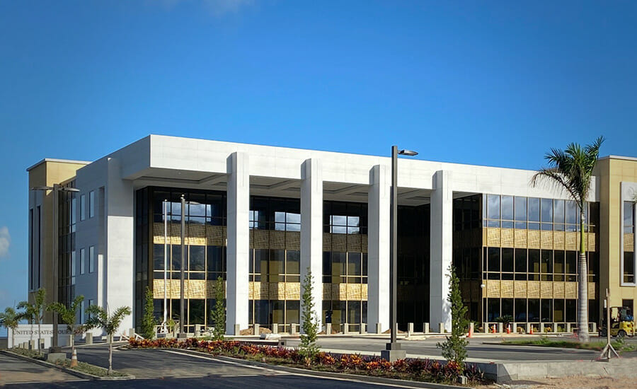
Jamaica Courthouse
Proposed Design

